Slide 1
SQL Caption Project Amazon Sales Data By Ganesh S

Slide 2
CONTENTS
1. Introduction
2. Data Wrangling
3. Feature Engineering
4. Exploratory Data Analysis(EDA)
5. Business Question Analysis & Insights
6. Conclusion

Slide 3
Objective
The major aim of this project is to gain insight into the sales data of Amazon to understand the different factors that affect sales of the different branches.
About Data
This dataset contains sales transactions from three different branches of Amazon, respectively located in Mandalay, Yangon and Naypyitaw. The data contains 17 columns and 1000 rows:

Slide 4
Data Wrangling
This is the first step where inspection of data is done to make sure NULL values and missing values are detected and data replacement methods are used to replace missing or NULL values.
1Build a database
2 Create a table and insert the data.
3 Select columns with null values in them. There are no null values in our database as in creating the tables, we set NOT NULL for each field, hence null values are filtered out.

Slide 5
Feature Engineering
This will help us generate some new columns from existing ones.
1 Add a new column named timeofday to give insight of sales in the Morning, Afternoon and Evening. This will help answer the question on which part of the day most sales are made.
2.Add a new column named dayname that contains the extracted days of the week on which the given transaction took place (Mon, Tue, Wed, Thur, Fri). This will help answer the question on which week of the day each branch is busiest.
3Add a new column named monthname that contains the extracted months of the year on which the given transaction took place (Jan, Feb, Mar). Help determine which month of the year has the most sales and profit.

Slide 6
Exploratory Data Analysis
Exploratory data analysis is done to answer the listed questions and aims of this project.

Slide 7
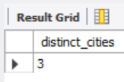
Business Question and Answer
1. What is the count of distinct cities in the dataset?
select count(distinct city) as distinct_cities from Amazon_Sales.Amazon;

Slide 8
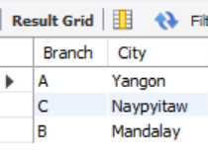
2. For each branch, what is the corresponding city?
select distinct Branch, City from Amazon_Sales.Amazon;

Slide 9
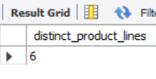
3. What is the count of distinct product lines in the Database?
SELECT COUNT(DISTINCT `Product line`) AS distinct_product_linesFROM Amazon_Sales.Amazon;

Slide 10
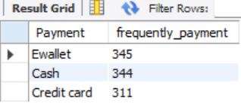
4. Which payment method occurs most frequently?
select Payment, count(Payment) as frequently_payment from Amazon_Sales.Amazongroup by Payment;

Slide 11
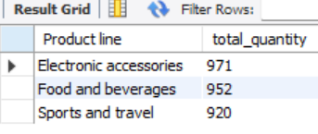
5. Which product line has the highest sales?
SELECT `Product line`, SUM(Quantity) AS total_quantity
FROM Amazon_Sales.Amazon
GROUP BY `Product line`
ORDER BY total_quantity desc
limit 3;

Slide 12
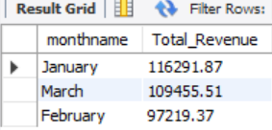

6. How much revenue is generated each month?
select monthname, round(sum(Total),2)as Total_Revenue
from Amazon_Sales.Amazon
group by monthname
order by Total_Revenue desc;

Slide 13
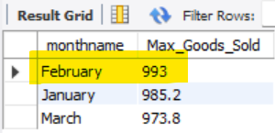
7. In which month did the cost of goods sold reach its peak?
select monthname, round(max(cogs), 2)as Max_Goods_Sold
from Amazon_Sales.Amazon
group by monthname
order by Max_Goods_Sold desc;

Slide 14
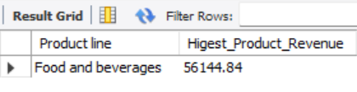
8. Which product line generated the highest revenue?
SELECT `Product line`, round(sum(Total),2) as Higest_Product_Revenue
from Amazon_Sales.Amazon
group by `Product line`
order by Higest_Product_Revenue desc
limit 1;

Slide 15

9. In which city was the highest revenue recorded?
select City, round(sum(Total),2)as City_Higest_Revenue
from Amazon_Sales.Amazon
group by City
order by City_Higest_Revenue desc
limit 1;

Slide 16

10. Which product line incurred the highest Value Added Tax?
SELECT `Product line`,max('Tax 5%')as MAX_VAT
from Amazon_Sales.Amazon
group by `Product line`
order by MAX_VAT desclimit 1;

Slide 17
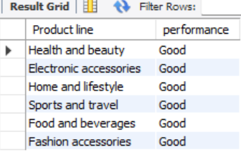
11. For each product line, add a column indicating "Good" if its sales are above average, otherwise "Bad."
SELECT `Product line`,
CASE
WHEN SUM(Quantity) > (SELECT AVG(total) FROM Amazon_Sales.Amazon) THEN 'Good'
ELSE 'Bad'
END AS performance
FROM Amazon_Sales.Amazon
GROUP BY `Product line`;

Slide 18

12. Identify the branch that exceeded the average number of products sold.
SELECT Branch FROM Amazon_Sales.Amazon
GROUP BY Branch
HAVING SUM(Quantity) >
(SELECT AVG(total) FROM (SELECT SUM(Quantity) AS total
FROM Amazon_Sales.Amazon
GROUP BY Branch) AS branch_totals);

Slide 19
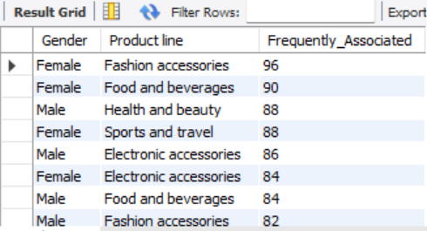
13. Which product line is most frequently associated with each gender?
select Gender, `Product line`, count(`Product line`) as Frequently_Associated
from Amazon_Sales.Amazon
group by Gender,`Product line`
order by Frequently_Associated desc

Slide 20
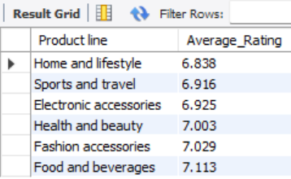
14. Calculate the average rating for each product line.
SELECT `Product line`, round(avg(Rating),3) as Average_Rating
from Amazon_Sales.Amazon
group by `Product line`
order by Average_Rating;

Slide 21
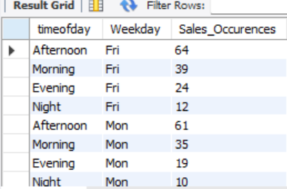
15. Count the sales occurrences for each time of day on every weekday.
select timeofday, date_format(date,'%a')as Weekday,count(Quantity) as Sales_Occurences
from Amazon_Sales.Amazon
group by timeofday,Weekday
order by weekday,Sales_Occurences desc;

Slide 22
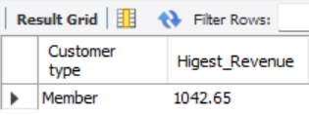
16. Identify the customer type contributing the highest revenue.
SELECT `Customer type`, max(total) AS Higest_Revenue
FROM Amazon_Sales.Amazon
GROUP BY `Customer type`
ORDER BY Higest_Revenue DESC
LIMIT 1;

Slide 23

17. What is the count of distinct payment methods in the dataset?
select count(distinct payment)as Dist_Payment
from Amazon_Sales.Amazon;

Slide 24
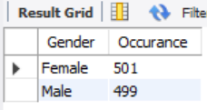
18. Which customer type occurs most frequently? 19. Identify the customer type with the highest purchase frequency.
select Gender, count(branch) as Occurance from
Amazon_Sales.Amazon
group by Gender

Slide 25

20. Determine the predominant gender among customers.
select Gender, count(*) as Predominant_Gender
from Amazon_Sales.Amazon
group by Gender
order by Predominant_Gender desc
limit 1;

Slide 26
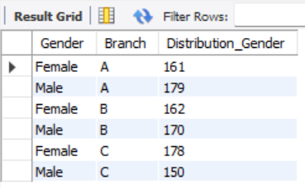
21. Examine the distribution of genders within each branch.
select Gender,Branch, count(branch) as Distribution_Gender
from Amazon_Sales.Amazon
group by Gender,Branch
order by Branch, Gender

Slide 27
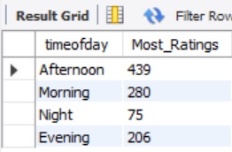
22. Identify the time of day when customers provide the most ratings.
select timeofday, count(Rating) as Most_Ratings
from Amazon_Sales.Amazon
group by timeofday

Slide 28
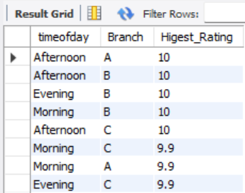
23. Determine the time of day with the highest customer ratings for each branch.
select timeofday,Branch,max(rating)as Higest_Rating
from Amazon_Sales.Amazon
group by Branch,timeofday
order by Higest_Rating desc

Slide 29
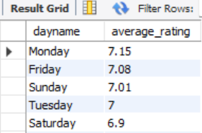
24. Identify the day of the week with the highest average ratings.
select dayname, round(avg(rating),2) as average_rating
from Amazon_Sales.Amazon
group by dayname
order by average_rating desc

Slide 30
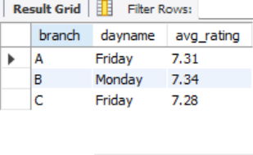
25. Determine the day of the week with the highest average ratings for each branch.
with AvgRatings as(
select branch,dayname,round(avg(rating),2) as avg_rating
from Amazon_Sales.Amazon
group by branch,dayname
)
select branch,dayname,avg_rating
from AvgRatings
where(branch,avg_rating) in (
select branch,max(avg_rating)
from AvgRatings
group by branch)
order by branch, avg_rating desc;

Slide 31
Summary Conclusion:
Branch Analysis:
>Each branch showed unique strength, with specific branches excelling in different time period and days of the week.
>For example, the highest average ratings for each branch varied by the day of the week, reflecting customer satisfacting peaks on different days.
2. Product Line Analysis:
> The product line associated with the highest total sales and revenue was consistently identified across queries, reflecting it’s dominance in the market.
> Gender analysis showed different product lines resonating more strongly with different genders, highlighting potential areas for targeted marketing.

Slide 32
3. Sales Trends:
> Sales were most frequent during specific times of day, with peak sales times providing insights into customer behaviour patterns.
> Similarly, certain days of the week saw higher average ratings, indicating customer preferences and potential opportunities for promotions.
4. Payment Methods:
> The most frequently used payment methods was identified, which could inform future payment options and promotions.
Thanking you,
Your Faithfully,
Ganesh S

